Slide 1

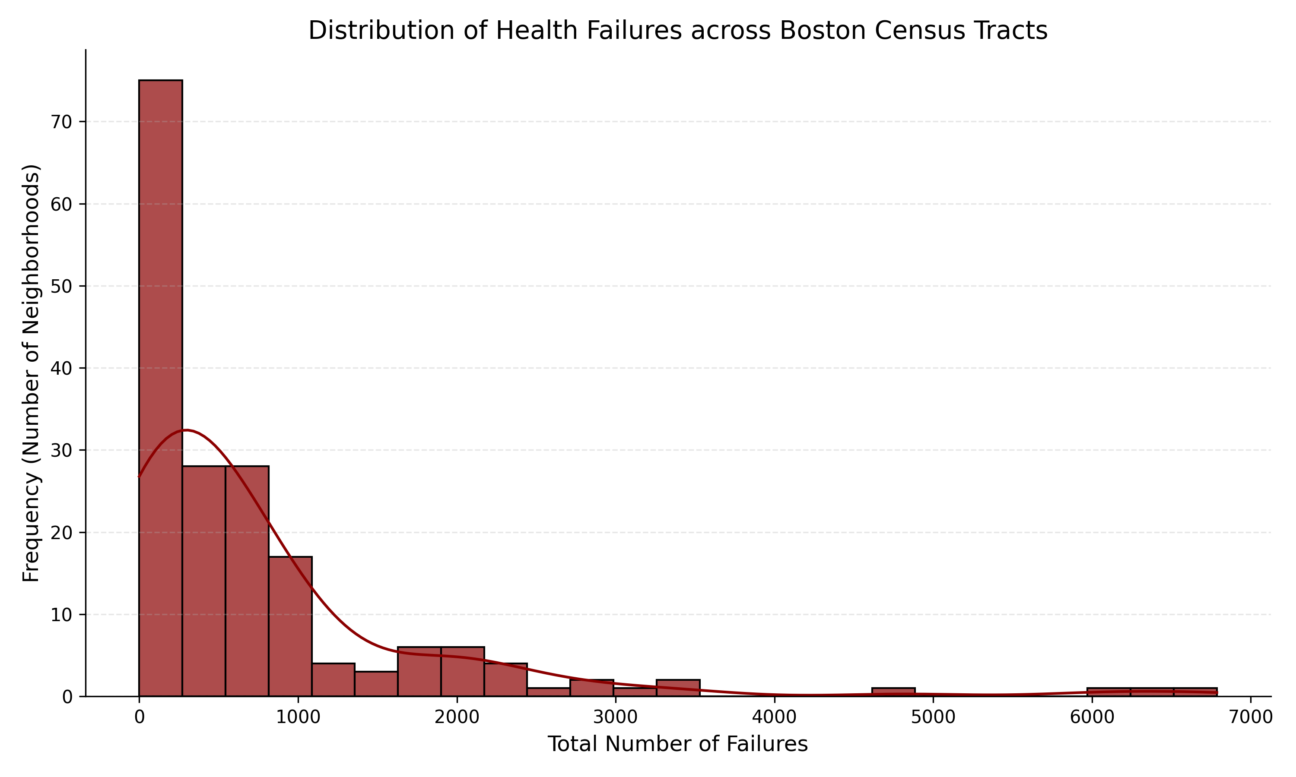
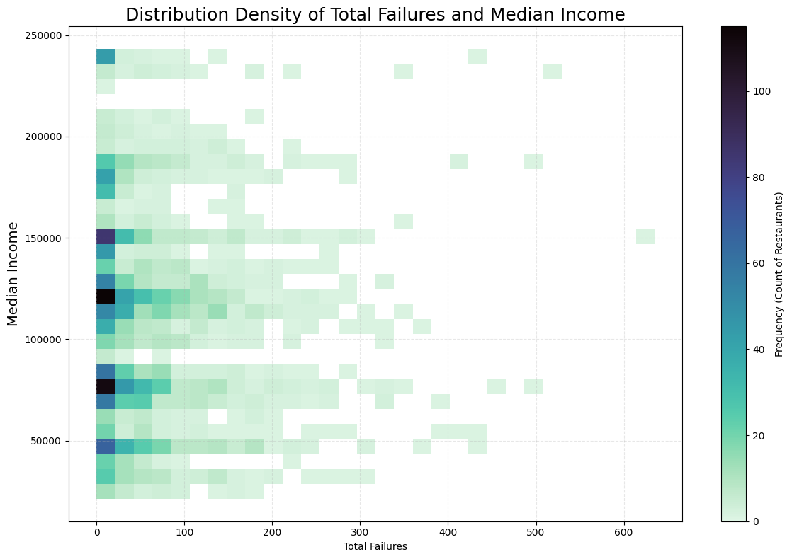
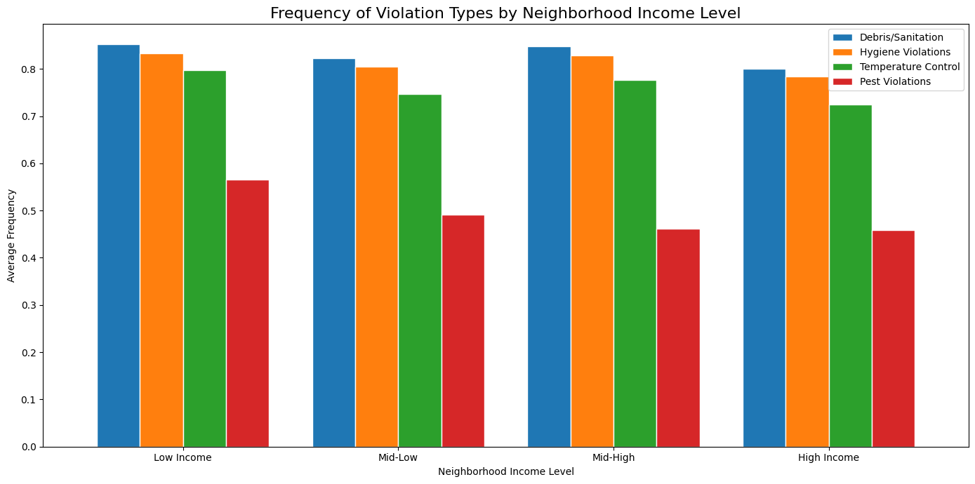
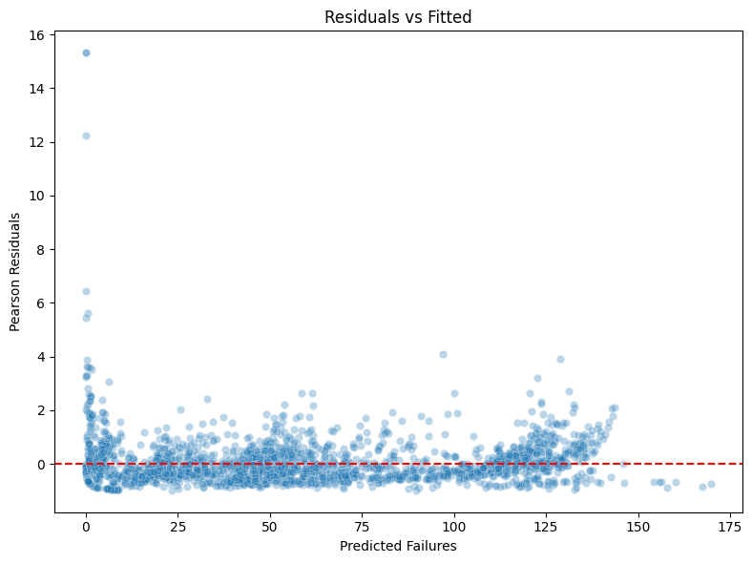
Utilizing Spatial Modeling and Socioeconomic Indicators to Optimize Public Health Resource Allocation in Boston
Sarah Yeh ’27 Data Science Major Capstone
Introduction
Visualizations
Methods/Results
Research Question
Which geographical areas (Census tracts) and types of food establishments in Boston exhibit the highest frequency and severity of health code violations between 2006 and 2026? How can predictive modeling of these patterns inform inspection resource allocation and identify establishments with the highest potential for intervention and improvement?
Background
Observation suggests that health code violations are disproportionately clustered in certain Boston census tracts. Understanding these geographical disparities is critical for optimizing the city’s limited public health resource.
Method
Data Integration: Merged 20 years of Boston Food Inspection data with Census Tract shapefiles using a spatial join. Missing spatial data (<5%) was excluded.
Feature Engineering: violation types, is_chain, income-pest interaction.
Model Specification: Utilized a Negative Bin Generalized Linear Model.
Train/Test split: Model was trained on data from 2006-2024 and validated using modern data from 2025-2026.
Results
Training Fit: The model achieved a Pseudo R^2 of 0.71.
Predictive Validity: On the 2025-2026 test set, the model maintained an R^2 of 0.55.
Data
Sources
Boston Food Inspection Data
US Census Tract Data (TIGER/Line Shapefiles)
Data Cleaning/Manipulation
Missing ZIP or violation levels are excluded because they are marginal. Only included violation levels: *, **, ***.
Created predictor variables: Month of inspection
Standardized ZIP codes, merged inspection data with the TIGER/Line shapefiles at the Census Tract level
Conclusions
High-Risk Areas: Although income alone isn’t the primary reason for higher violations in restaurants, the Income-Pest Interaction proves that lower-income tracts are vulnerable to structural building issues that multiply the impact of pests.
Establishment types: Independent restaurants are significantly higher risk than corporate chains to inspection violations.
Discussions and Limitations
Discussion
Operational flags (Debris/Hygiene) remain the strongest predictors, increasing the risk of violation failures by ~300%. This proves that restaurant management is the main reason for health violations, regardless of neighborhood. The Income-Pest Interaction term shows that poverty acts as a risk multiplier. Thus, in lower-income tracts, structural barriers may result in more difficult restaurant management and health maintenance.
Limitations
Some limitations may include a reporter and observer bias as there is a potential for higher complain rates in wealthy tracts and increased inspections in lower-income areas. Additionally, the dataset lacks variables such as staff turnover rates, which may contribute to the higher failure rates in inspections. The analysis underwent some loss of data when data cleaning and merging Census tract data with the inspection data, which may result in an under representative sample of volatile neighborhoods.

